Slide 1
Logikal API V3
Ofcas.Lk.Api.V3

Slide 2
Agenda
Purpose
Architecture
Documentation / Support
Demonstration

Slide 3
Purpose
Remotely controlling LogiKal
Client-Application
LogiKal
Remote Control
Database

Slide 4
What do we want to control remotely?
Managing projects
Create, delete, copy, move, import projects …
Editing projects
Editing elevations
Managing documents
Generating reports
Manufacturing

Slide 5
How?
With a Windows application
  Windows 7 or better
  32/64 bit
C# - Interface (Separation of UI and Core methods)
Process separation: API-Client and LogiKal
Simple methods & easy usage

Slide 6
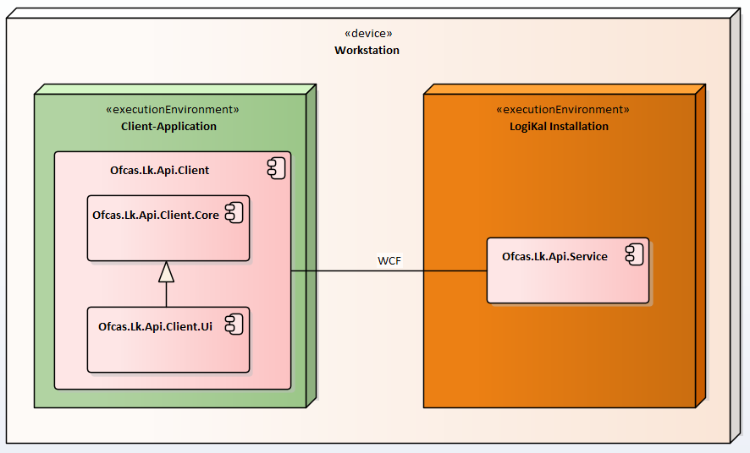
Architecture
Layer without UI methods
Layer with UI methods

Slide 7
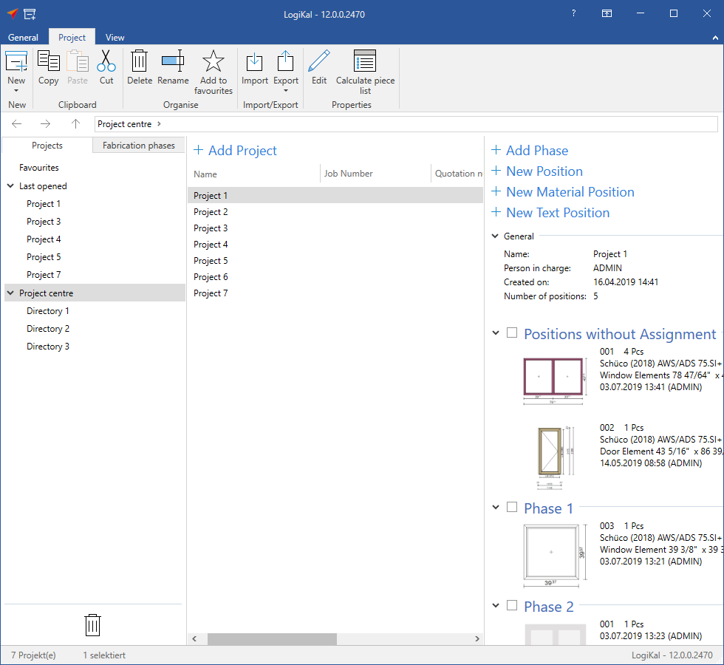
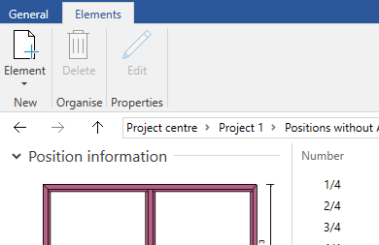
Hierarchical
Structure
Login Scope
Directory
Metadata
Project
Documents
Phase
Elevation
Element

Slide 8
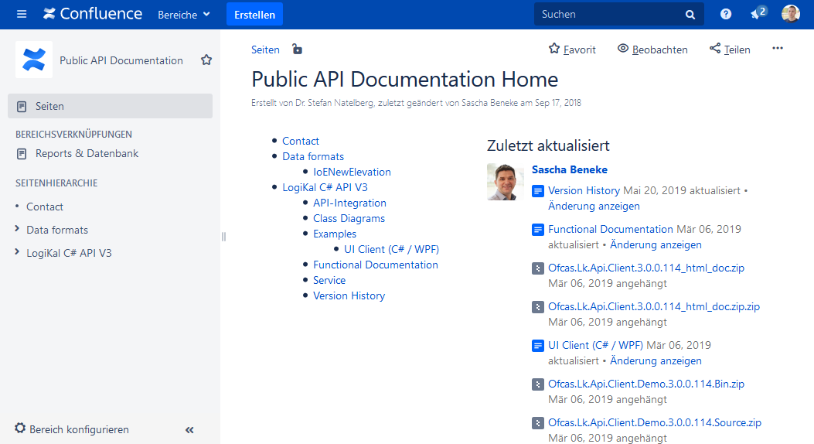
Documentation / Support
Detailed information can be found
on our Confluence page for customers
  Functional documentation
  Code snippets
  example programs
  class diagrams
  ….
Public API Documentation - Confluence

Slide 9
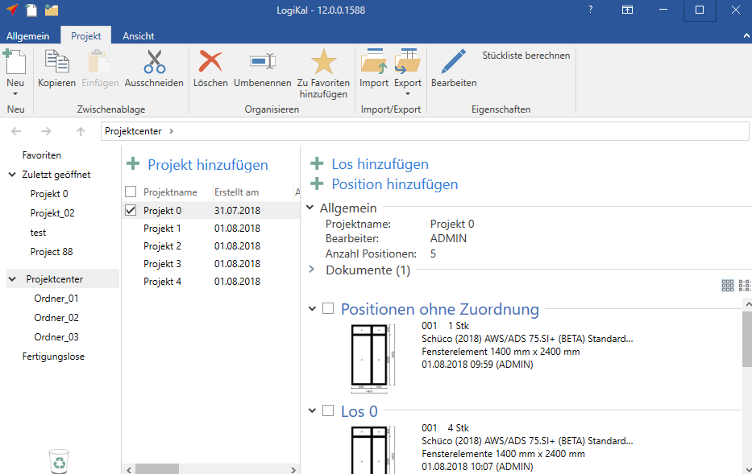
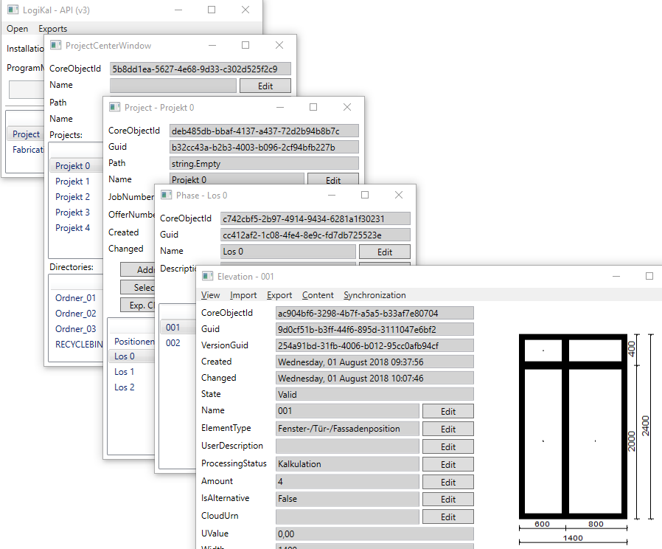
Demo
Logikal
Ofcas.Lk.Api.V3.Demo

